Slide 1
2022 Georgia Press Association
Advertising Contest Winners
Real Estate
Motor Vehicle
Health Care
Food
Service
Institutional
Home Furnishing
Apparel, Jewelry
Non-Traditional
Miscellaneous
Use of Color
Newspaper
Promotion
Promotion
Out of Print
Special Section
Classified
Signature Page
Small Page Ad
Ad Campaign
Idea of the Year

Slide 2
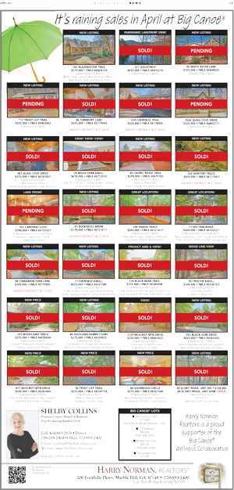
Real Estate
Division F
2nd Place
Harry Norman Realty/Shelby Collins
Smoke Signals, Big Canoe

Slide 3

Real Estate
Division F
1st Place
Georgia Views Realty
Smoke Signals, Big Canoe

Slide 4

Real Estate
Division E
2nd Place
Harbor Club
The Baldwin Bulletin, Milledgeville

Slide 5

Real Estate
Division E
1st Place
Boatright Coldwell Banker
The Baldwin Bulletin, Milledgeville

Slide 6
Real Estate
Division D
2nd Place
Robert Boatright – Coldwell Banker
The Eatonton Messenger

Slide 7
Real Estate
Division D
1st Place
Watson Realty/ Relocation Services
Tribune & Georgian,
St. Mary’s

Slide 8

Real Estate
Division C
2nd Place
Harris Real Estate
The Press-Sentinel, Jesup

Slide 9

Real Estate
Division C
1st Place
Malcom & Malcom Realty Professionals
The Walton Tribune, Monroe

Slide 10

Real Estate
Division B
2nd Place
EXP Realty
The Valdosta Daily Times

Slide 11

Real Estate
Division B
1st Place
The Herndon Company
The Valdosta Daily Times

Slide 12

Real Estate
Division A
2nd Place
Michael Harris Team Realtors
The Brunswick News

Slide 13

Real Estate
Division A
1st Place
Berkshire Hathaway
The Brunswick News

Slide 14

Motor Vehicle
Division E
2nd Place
Protective Solutions
The Covington News

Slide 15

Motor Vehicle
Division E
1st Place
Dent Scene
The Covington News

Slide 16

Motor Vehicle
Division D
2nd Place
Athens BMW
The Eatonton Messenger

Slide 17

Motor Vehicle
Division D
1st Place
• Franklin’s Ford
The Post-Searchlight, Bainbridge

Slide 18

Motor Vehicle
Division C
2nd Place
Loganville Ford
The Walton Tribune, Monroe

Slide 19

Motor Vehicle
Division C
1st Place
University Tire
The Walton Tribune, Monroe

Slide 20

Motor Vehicle
Division B
2nd Place
Shottenkirk Honda
The Daily Tribune News, Cartersville

Slide 21

Motor Vehicle
Division B
1st Place
West Georgia Boat Center
LaGrange Daily News

Slide 22

Motor Vehicle
Division A
2nd Place
Step One Automotive Group
The Brunswick News

Slide 23

Motor Vehicle
Division A
1st Place
Step One Automotive Group
The Brunswick News

Slide 24

Health Care
Division E
2nd Place
Choice One Dental
The Baldwin Bulletin, Milledgeville

Slide 25

Health Care
Division E
1st Place
Magnolia Estates Senior Living
The Elberton Star

Slide 26
Health Care
Division D
2nd Place
Choice One Dental
The Eatonton Messenger

Slide 27

Health Care
Division D
1st Place
Northgate Station Comprehensive Dentistry
Smoke Signals, Big Canoe

Slide 28

Health Care
Division C
2nd Place
Monroe Pediatrics
The Walton Tribune, Monroe

Slide 29

Health Care
Division C
1st Place
Village Park Senior Living
Appen Media Group

Slide 30

Health Care
Division B
2nd Place
Heart & Vascular Care of Georgia
LaGrange Daily News

Slide 31

Health Care
Division B
1st Place
McIntosh Trail Family Medicine
The Griffin Daily News

Slide 32

Health Care
Division A
2nd Place
M. Dawn Harvey DMD
West Georgia Woman Magazine

Slide 33

Health Care
Division A
1st Place
M. Dawn Harvey DMD
West Georgia Woman Magazine

Slide 34

Food
Division F
2nd Place
Barnyard Spirits
Appen Media Group

Slide 35

Food
Division F
1st Place
Delightful Donuts
Appen Media Group

Slide 36

Food
Division E
2nd Place
Bread & Butter
The Covington News

Slide 37

Food
Division E
1st Place
Big Jim’s
Donalsonville News

Slide 38

Food
Division D
2nd Place
Support Local Restaurants
The Hartwell Sun

Slide 39

Food
Division D
1st Place
Jabaley’s Liquor Store
The Newnan Times-Herald

Slide 40

Food
Division C
2nd Place
South on Broad Kitchen & Bar
The Walton Tribune, Monroe

Slide 41
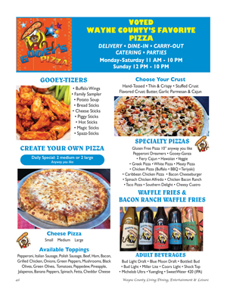
Food
Division C
1st Place
Gooey’s Pizza
The Press-Sentinel, Jesup

Slide 42

Food
Division B
2nd Place
The Stockyard
LaGrange Daily News

Slide 43

Food
Division B
1st Place
Jefferson’s
Times-Georgian, Carrollton

Slide 44

Food
Division A
2nd Place
Shorebirds Package
The Brunswick News

Slide 45

Food
Division A
1st Place
Sandy Bottom Bagels
The Brunswick News
Notes:
45

Slide 46

Service/
Institutional
Division F
2nd Place
Ingram Funeral Home & Crematory
Appen Media Group

Slide 47

Service/
Institutional
Division F
1st Place
Manor Lake Assisted Living
Smoke Signals, Big Canoe

Slide 48

Service/
Institutional
Division E
2nd Place
LMC Salute to Agriculture
Donalsonville News

Slide 49

Service/
Institutional
Division E
1st Place
Salem United Methodist Church
The Covington News

Slide 50

Service/
Institutional
Division D
2nd Place
The H.E.L.P. Spay & Neuter Clinic
The Newnan Times-Herald

Slide 51

Service/
Institutional
Division D
1st Place
Farm Credit
The Post-Searchlight, Bainbridge

Slide 52

Service/
Institutional
Division C
2nd Place
City of Social Circle
The Walton Tribune, Monroe

Slide 53

Service/
Institutional
Division C
1st Place
Welcome to Monroe
The Walton Tribune, Monroe

Slide 54

Service/
Institutional
Division B
2nd Place
Bennett Trust & Estate Elder Law
The Valdosta Daily Times

Slide 55

Service/
Institutional
Division B
1st Place
The Barn at Nalley Properties Inc.
Times-Georgian, Carrollton

Slide 56

Service/
Institutional
Division A
2nd Place
Dailey Life Photography
West Georgia Woman Magazine

Slide 57
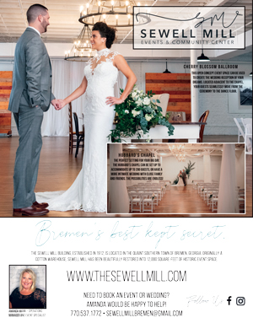
Service/
Institutional
Division A
1st Place
Sewell Mill Events & Community Center
West Georgia Woman Magazine

Slide 58

Home Furnishings
& Appliances
Division F
2nd Place
Ariana Home Furnishings & Design
Smoke Signals, Big Canoe

Slide 59

Home Furnishings
& Appliances
Division F
1st Place
Ariana Home Furnishings & Design
Smoke Signals, Big Canoe

Slide 60

Home Furnishings
& Appliances
Division E
2nd Place
Hardy’s Floor
The Covington News

Slide 61

Home Furnishings
& Appliances
Division E
1st Place
Interior Beauty Designs
The Covington News

Slide 62

Home Furnishings & Appliances
Division D
2nd Place
Loosier Furniture
The Jones County News, Gray

Slide 63

Home Furnishings & Appliances
Division D
1st Place
Macon & Robbins Bedroom & Mattress
The Jones County News, Gray

Slide 64

Home Furnishings
& Appliances
Division C
2nd Place
Britt’s
The Walton Tribune, Monroe

Slide 65

Home Furnishings
& Appliances
Division C
1st Place
Peters & Foster Furniture
The Walton Tribune, Monroe

Slide 66

Home Furnishings
& Appliances
Division A
2nd Place
Taylor House Interiors
The Brunswick News

Slide 67

Home Furnishings
& Appliances
Division A
1st Place
Gina D’Amico Interiors
The Brunswick News

Slide 68

Apparel, Jewelry
& Accessories
Division F
2nd Place
Woodlands Edge
Smoke Signals, Big Canoe

Slide 69

Apparel, Jewelry
& Accessories
Division F
1st Place
Buckley Vineyards
Smoke Signals, Big Canoe

Slide 70

Apparel, Jewelry
& Accessories
Division D
2nd Place
Morgan Jewelers
The Newnan Times-Herald

Slide 71

Apparel, Jewelry
& Accessories
Division D
1st Place
Winne J’s Boutique
The Hartwell Sun

Slide 72

Apparel, Jewelry
& Accessories
Division A
2nd Place
Gentlemen’s & Lady Outfitters
The Brunswick News

Slide 73

Apparel, Jewelry
& Accessories
Division A
1st Place
Mixed Nuts
The Brunswick News

Slide 74

Non-Traditional
Division D
2nd Place
Guide To Camden
Tribune & Georgian, St. Mary’s

Slide 75

Non- Traditional
Division D
1st Place
Newnan Coweta Magazine
The Newnan Times-Herald

Slide 76

Non-Traditional
Division C
2nd Place
City of Monroe Bicentennial
The Walton Tribune, Monroe

Slide 77

Non-Traditional
Division C
1st Place
Visions 2021
The Walton Tribune, Monroe

Slide 78

Non-Traditional
Division B
2nd Place
Taylor Outdoor
The Daily Tribune News, Cartersville

Slide 79

Non-Traditional
Division B
1st Place
Toyo Tire
The Daily Tribune News, Cartersville

Slide 80

Non-Traditional
Division A
2nd Place
Coastal Cuisine 2021
The Brunswick News

Slide 81

Non-Traditional
Division A
1st Place
Cobb County Factbook
Marietta Daily Journal

Slide 82

Miscellaneous
Division F
2nd Place
Mountain Moonshine Festival
Smoke Signals, Big Canoe

Slide 83

Miscellaneous
Division F
1st Place
ElectroBike
Springs Publishing Inc.

Slide 84

Miscellaneous
Division E
2nd Place
Horace J Johnson Foundation
The Covington News

Slide 85

Miscellaneous
Division E
1st Place
Lake Sinclair Map Pad
The Baldwin Bulletin, Milledgeville

Slide 86

Miscellaneous
Division D
2nd Place
Lake Oconee Map Pad
Lake Oconee News, Greensboro

Slide 87

Miscellaneous
Division D
1st Place
Fellowship Christian Center
The Newnan Times-Herald

Slide 88

Miscellaneous
Division C
2nd Place
Social Circle Ace Hardware
The Walton Tribune, Monroe

Slide 89

Miscellaneous
Division C
1st Place
The Grove Company Home & Garden
The Press-Sentinel, Jesup

Slide 90

Miscellaneous
Division B
2nd Place
Henderson and Sons
Rome News-Tribune

Slide 91

Miscellaneous
Division B
1st Place
Spalding County Pickle Ball Association
The Griffin Daily News

Slide 92

Miscellaneous
Division A
2nd Place
Coastal Eye Care
The Brunswick News

Slide 93

Miscellaneous
Division A
1st Place
SoGlo Guitar Gallery
The Brunswick News

Slide 94

Online Banner Ad
Division E
2nd Place
Duct Dusters
The Covington News
Notes:
94

Slide 95

Online Banner Ad
Division E
1st Place
Hibachi Grill Express
The Covington News

Slide 96

Online Banner or Tile Ad
Division D
2nd Place
Wadsworth Auditorium
The Newnan Times-Herald

Slide 97

Online Banner or Tile Ad
Division D
1st Place
Special Olympics Georgia
The Newnan Times-Herald
Notes:
97

Slide 98

Online Banner or Tile Ad
Division B
2nd Place
Sunbelt Ag Expo
The Valdosta Daily Times
Notes:
98

Slide 99

Online Banner or Tile Ad
Division B
2nd Place
Chris Mills Homes
The Valdosta Daily Times
Notes:
99

Slide 100

Online Banner or Tile Ad
Division A
2nd Place
Daily Double Digit Pledge
The Brunswick News
Notes:
100

Slide 101
Online Banner or Tile Ad
Division A
1st Place
Your Support of Local Journalism
The Brunswick News
Notes:
101

Slide 102

Full
Color
Division F
2nd Place
Manor Lake
Smoke Signals, Big Canoe

Slide 103

Full Color
Division F
1st Place
Ariana Home Furnishing and Designs
Smoke Signals, Big Canoe

Slide 104

Full Color
Division E
2nd Place
Fox Vineyards and Winery
The Covington News

Slide 105

Full
Color
Division E
1st Place
Peach County Schools
The Leader Tribune, Fort Valley

Slide 106

Full Color
Division D
2nd Place
Lions Club Fair
The Jones County News, Gray

Slide 107

Full
Color
Division D
1st Place
First National Bank
The Post-Searchlight, Bainbridge

Slide 108

Full
Color
Division C
2nd Place
Treeman Tree and Stump Removal
The Walton Tribune, Monroe

Slide 109

Full
Color
Division C
1st Place
Welcome to Monroe
The Walton Tribune, Monroe

Slide 110
Full
Color
Division B
2nd Place
Jefferson’s
Times-Georgian, Carrollton

Slide 111

Full
Color
Division B
1st Place
Troncalli Insurance
Times-Georgian, Carrollton
Notes:
111

Slide 112
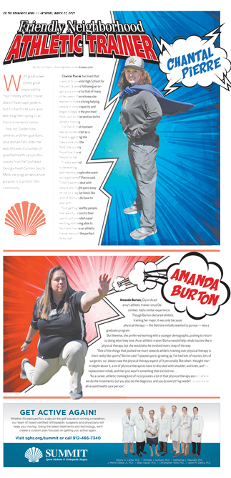
Full
Color
Division A
2nd Place
Southeast Georgia Health System
The Brunswick News
Notes:
112

Slide 113

Full
Color
Division A
1st Place
West Georgia Urology
West Georgia Woman Magazine
Notes:
113

Slide 114

Spot Color
Division C
2nd Place
Makers Market
The Newnan Times-Herald
Notes:
114

Slide 115

Spot Color
Division C
1st Place
Bullseye Accounting Services
The Walton Tribune, Monroe
Notes:
115

Slide 116

Spot Color
Division A
2nd Place
West Georgia Ambulance Inc.
West Georgia Woman Magazine
Notes:
116

Slide 117

Spot Color
Division A
1st Place
West Georgia Ambulance Inc.
West Georgia Woman Magazine
Notes:
117

Slide 118

Newspaper Promotion
Division F
2nd Place
Smoke Signals Weekly
Smoke Signals, Big Canoe

Slide 119

Newspaper Promotion
Division F
1st Place
All Aboard
Smoke Signals, Big Canoe

Slide 120

Newspaper Promotion
Division E
2nd Place
We are Social Media too!
Donalsonville News

Slide 121
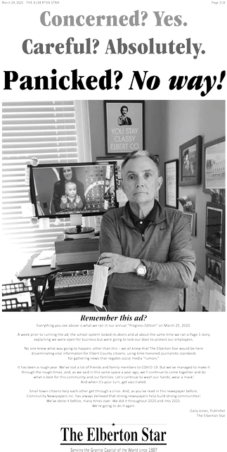
Newspaper Promotion
Division E
1st Place
100% Vaccinated
The Elberton Star

Slide 122

Newspaper Promotion
Division D
2nd Place
Heroes Among Us
The Newnan Times-Herald

Slide 123

Newspaper
Promotion
Division D
1st Place
We Build Brands
The Post-Searchlight, Bainbridge

Slide 124

Newspaper
Promotion
Division C
2nd Place
Traeger Grill Giveaway
The Walton Tribune, Monroe

Slide 125

Newspaper
Promotion
Division C
1st Place
Explosive News!
The Press-Sentinel, Jesup

Slide 126

Newspaper
Promotion
Division B
2nd Place
Redesigned Website
The Daily Tribune News, Cartersville

Slide 127

Newspaper
Promotion
Division B
1st Place
75th Anniversary
The Daily Tribune News, Cartersville

Slide 128

Newspaper
Promotion
Division A
2nd Place
Saluting Our Newspaper Carriers
The Brunswick News

Slide 129

Newspaper
Promotion
Division A
1st Place
The Daily Double Digit Pledge
The Brunswick News

Slide 130

Promotion
Out of Print
Division A
2nd Place
Hand Mirror
West Georgia Magazine

Slide 131

Promotion
Out of Print
Division A
1st Place
Digital Subscription
The Valdosta Daily Times

Slide 132

Special
Section
Division E
2nd Place
Veterans Day
The Covington News

Slide 133

Special
Section
Division E
1st Place
Lake Country Football Preview
The Baldwin Bulletin, Milledgeville

Slide 134

Special
Section
Division D
2nd Place
Veterans Day 2021
The Jones County News, Gray

Slide 135

Special
Section
Division D
1st Place
Hometown Heroes
The Newnan Times-Herald

Slide 136
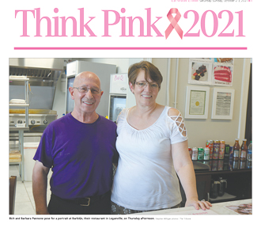
Special
Section
Division C
2nd Place
Think Pink
The Walton Tribune, Monroe

Slide 137

Special
Section
Division C
1st Place
Memorial Day Section
The Walton Tribune, Monroe

Slide 138

Special
Section
Division B
2nd Place
Trevor Lawrence Special Section
The Daily Tribune News, Cartersville

Slide 139

Special
Section
Division B
1st Place
40 Under 40
Times-Georgian, Carrollton

Slide 140

Special
Section
Division A
2nd Place
Discover Downtown Brunswick
The Brunswick News

Slide 141

Special
Section
Division A
1st Place
Defending #1
The Brunswick News

Slide 142

Classified Section/Page
Division E
2nd Place
Donalsonville News Classifieds
Donalsonville News
Notes:
142

Slide 143

Classified Section/Page
Division E
1st Place
Classifieds
The Moultrie Observer
Notes:
143

Slide 144

Classified Section/Page
Division D
2nd Place
Classifieds
The Newnan Times-Herald
Notes:
144

Slide 145

Classified Section/Page
Division D
1st Place
Classifieds
The Newnan Times-Herald
Notes:
145

Slide 146

Classified Section/Page
Division B
2nd Place
Classified Marketplace
LaGrange Daily News
Notes:
146

Slide 147

Classified Section/Page
Division B
1st Place
Times-Georgian Marketplace
Times-Georgian, Carrollton
Notes:
147

Slide 148
Classified Section/Page
Division A
2nd Place
The Brunswick News
Notes:
148

Slide 149
Classified Section/Page
Division A
1st Place
The Brunswick News
Notes:
149

Slide 150

Signature
Page
Division F
2nd Place
Holiday Collection
Smoke Signals, Big Canoe

Slide 151

Signature
Page
Division F
1st Place
Memorial Day
Appen Media Group

Slide 152

Signature
Page
Division E
2nd Place
12 Great Reasons to Buy Local
The Moultrie Observer

Slide 153

Signature
Page
Division E
1st Place
9/11 We Remember
Donalsonville News

Slide 154
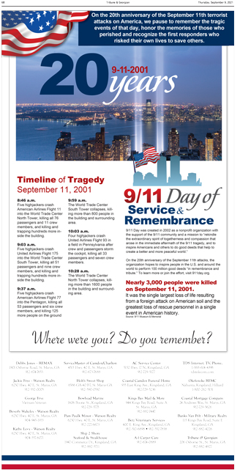
Signature
Page
Division D
2nd Place
9-11 Share Page
Tribune & Georgian, St. Mary’s

Slide 155
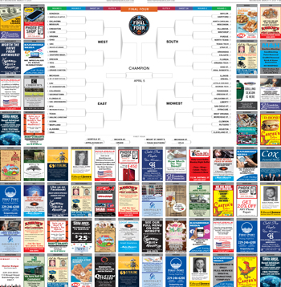
Signature
Page
Division D
1st Place
Hoops
The Post-Searchlight, Bainbridge

Slide 156
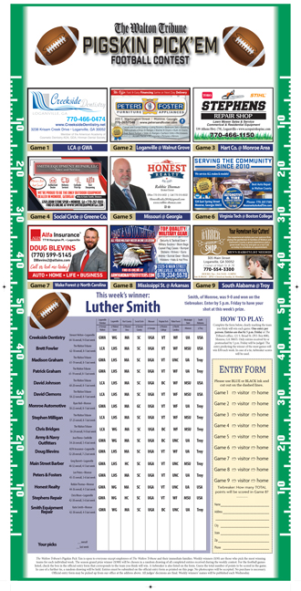
Signature
Page
Division B
2nd Place
Pigskin Pick ’Em Contest
The Walton Tribune, Monroe
Notes:
156

Slide 157

Signature
Page
Division B
1st Place
Salute to Public Servants
The Daily Tribune News, Cartersville
Notes:
157

Slide 158

Signature
Page
Division A
2nd Place
Business Card Directory
The Brunswick News
Notes:
158

Slide 159

Signature Page
Division A
1st Place
Paige Aiken - Map
The Brunswick News
Notes:
159

Slide 160

Small Page
Ad
Division F
2nd Place
The Lazy Bear
Smoke Signals, Big Canoe

Slide 161

Small Page
Ad
Division F
1st Place
Solar Nails
Smoke Signals, Big Canoe

Slide 162

Small Page
Ad
Division E
2nd Place
Alpha Pregnancy Center
Donalsonville News

Slide 163

Small Page
Ad
Division E
1st Place
Cow Pie Bingo
Donalsonville News

Slide 164

Small Page Ad
Division D
2nd Place
Two Rivers Gun Range
Tribune & Georgian, St. Marys

Slide 165

Small Page
Ad
Division D
1st Place
Easter Sunrise Service
The Eatonton Messenger

Slide 166
Small Page
Ad
Division C
2nd Place
Watermelon Gumballs
The Press-Sentinel, Jesup

Slide 167

Small Page
Ad
Division C
1st Place
Chandler Exterminators
Douglas County Sentinel, Douglasville

Slide 168

Small Page
Ad
Division B
2nd Place
Bowdon Main Street
Times-Georgian, Carrollton

Slide 169

Small Page
Ad
Division B
1st Place
Vote Jacqueline Roberts for Mayor
Times-Georgian, Carrollton

Slide 170

Small Page
Ad
Division A
2nd Place
Clearwater Tan and Spa
West Georgia Woman Magazine

Slide 171

Small Page
Ad
Division A
1st Place
A Southern Wedding Flower
West Georgia Woman Magazine

Slide 172

Advertising
Campaign
Division E
2nd Place
SPLOST for Education
Donalsonville News

Slide 173
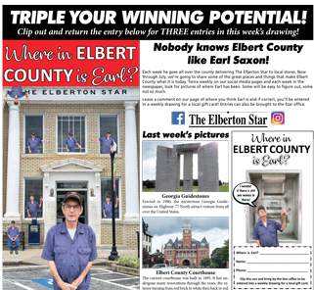
Advertising
Campaign
Division E
1st Place
Where in Elbert County is Earl?
The Elberton Star

Slide 174

Advertising
Campaign
Division D
2nd Place
Kiwanis Fair
The Newnan Times-Herald

Slide 175

Advertising
Campaign
Division D
1st Place
Blinds by Design
Smoke Signals

Slide 176

Advertising
Campaign
Division A
2nd Place
Dollar Heating and Air
West Georgia Woman Magazine

Slide 177

Advertising
Campaign
Division A
1st Place
West Georgia Urology
West Georgia Woman Magazine

Slide 178
Idea of the
Year
Weekly
Division
• Buckley Vineyards
• Smoke Signals, Big Canoe

Slide 179
Idea of the
Year
Daily Division
M. Dawn Harvey DMD P.C.
West Georgia Woman Magazine

Slide 180
Congratulations To
All 2022 Winners!

